Slide 1

OGC ISG Year 2 Sprint Kickoff :
Jordan Dauble – Owner
Glen Johnson – Principal Software Developer
Danie Conradie – Principal Software Developer
Notes:
Couple seconds: mention names of organization and primary contacts

Slide 2
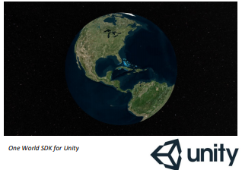
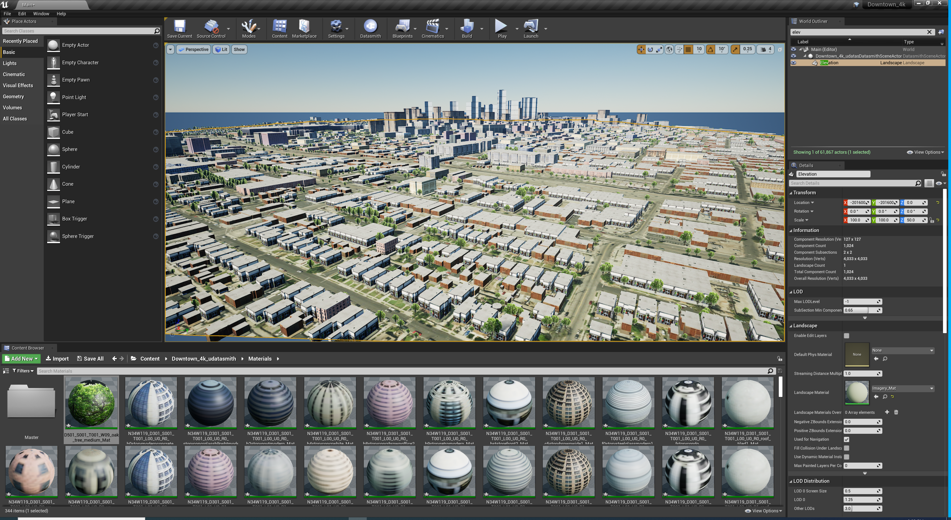
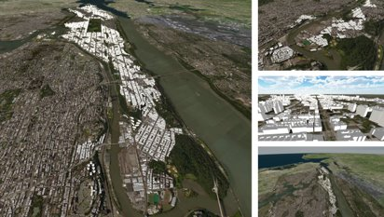


SimBlocks.io Vision
Core Capabilities
Software Development
Game Engine Development
Virtual Reality, Augmented Reality, Mixed Reality (VR, AR, MR)
Live, Virtual, Constructive, Gaming (LVC&G) interoperability solutions
Vision
Leverage commercial game engines to simulate a digital twin of the real world.
Standards Experience
OpenFlight
CDB
GeoVolumes
3D Tiles
glTF
GeoPackage
CDB SDK
3D Tiles SDK

Slide 3
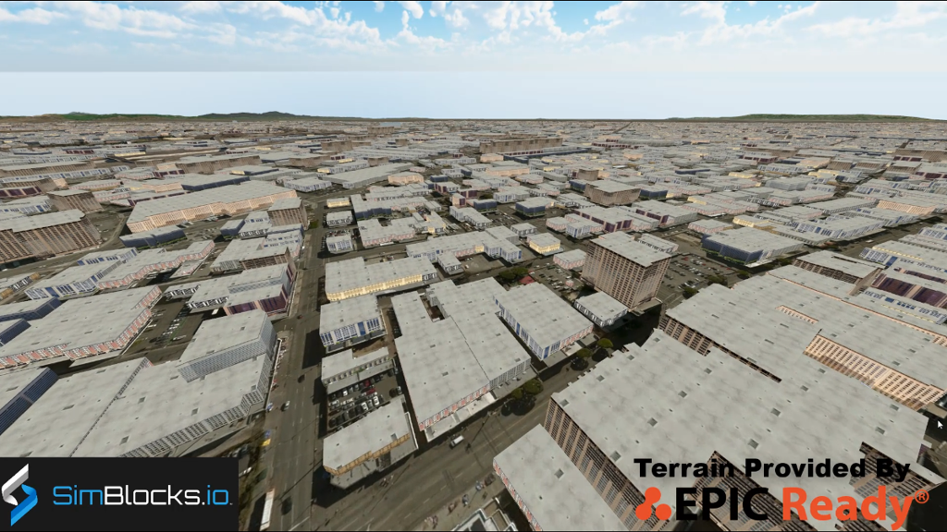
CDB Terrains in Unity

Slide 4

One World SDK for Unity

Slide 5
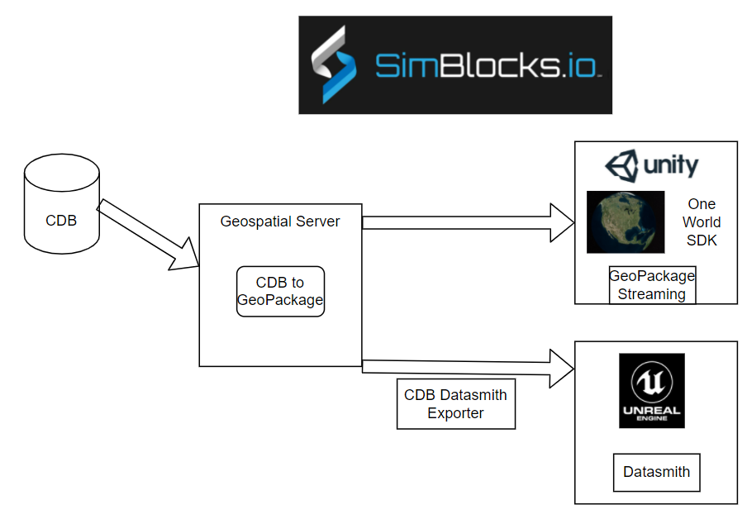
Architecture Diagram

Slide 6
Proposed Activities – Scenario 1
Scenario 1B - Conversion
Batch conversion of CDB to GeoPackage
Convert OpenFlight models to glTF binary encodings stored in GeoPackage.
Define an xml structure to allow varying packaging of the GeoPackage output
from the CDB. (tiling structure, layer content, model formats)
San Diego CDB will at least be supported in this effort. Others?
Scenario 1B - Visualization
Visualize terrains in Unity and Unreal game engines.
Integrate with Unity by loading GeoPackage on top of the One World SDK for Unity to enable visualizing geospecific 3D content with a world-wide base terrain
Integrate with Unreal using SimBlocks.io CDB Runtime Publisher SDK for Unreal

Slide 7
Proposed Activities – Scenario 3
Scenario 3
Leverage a procedural city generation capability that SimBlocks has developed to quick create 3D content from source data including imagery, elevation, and building footprints.
Current generation tool has focused on geotypical and geospecific 3D buildings.
Scenario 3 – Transportation
Add transportation elements procedurally to this database using additional openly available and sharable data sources, which will then be added to the GeoPackage.
Enhance the tool to support traffic simulation on roads and rails.
Integrate historical flight information to show an aircraft flying over the city.

Slide 8







The end.
Building Blocks for High Fidelity Simulations
THANK YOU!
Jordan Dauble, Owner
Jordan.Dauble@SimBlocks.io
Glen Johnson, Principal Software Developer
Glen.Johnson@SimBlocks.io
Danie Conradie, Principal Software Developer
Danie.Conradie@SimBlocks.io

